Slide 1

Software Design and Architecture [Software Architecture] – Chapter 02, L03

Slide 2
Lecture Outlines
Designing the Architecture with the 4+1 view model
  The logical view
  The process view
  The development view
  The physical view
  Plus … The user view

Slide 3
Designing the Architecture
When designing the architecture of a software system, there is no single view that can present all system aspects
Instead, software designers can organize the description of their architectural decisions using a collection of different views (why?)
Specific views can provide partial representation of the software architecture to a specific stakeholder (e.g. system users, analysts, developers, etc.)
A popular model is usually used for designing different architectural views is the 4+1 view model

Slide 4
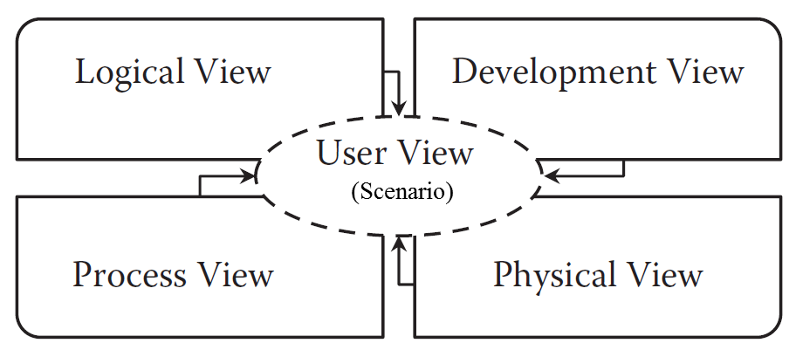
The 4+1 View Model
The 4+1 view model was originally introduced by Philippe Kruchten in 1995.
The model provides four essential views: the logical view, the process view, the physical view, and the development view.
To ensure consistency among all 4 views, the user’s perspective is captured through several use cases, as part of the user view

Slide 5
The logical View
The logical view specifies system decomposition into conceptual entities (such as objects or classes) and the connection between these entities
The view basically is an abstraction of the system's functional requirements
The logical view is usually modeled using:
    Static diagrams such as: class/object diagram
    Dynamic diagrams such as: interaction overall diagram, sequence diagram, communication diagram, state diagram, and activity diagram
The usual stakeholders of the logical view are the end-users, analysts, and designers.

Slide 6
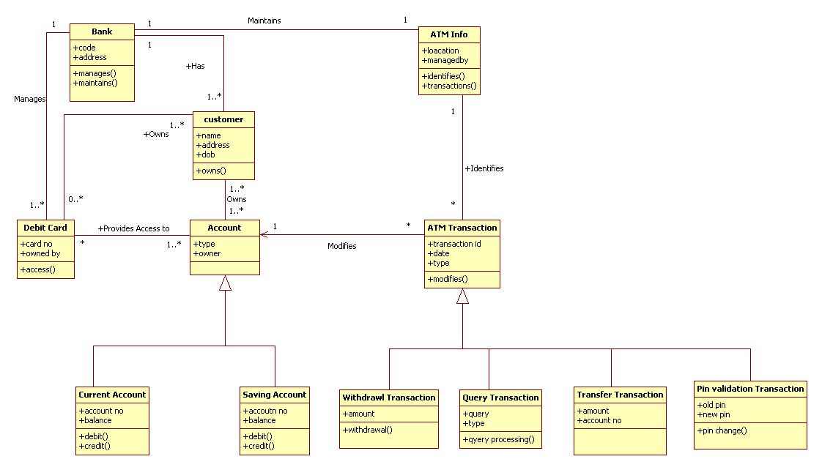
*ATM Example – Logical View (Class Diagram)
Class diagrams :
show the classes of the system, their inter-relationships, and the operations and attributes of the classes
* Example taken from: http://www.programsformca.com/2012/03/uml-diagrams-library-mgmt-system.html

Slide 7
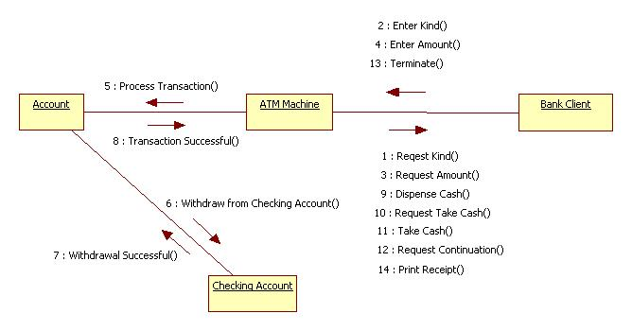
*ATM Example – Logical View (Communication Diagram)
Communication diagram: is more focused on showing the communication between main entities
* Example taken from: http://www.programsformca.com/2012/03/uml-diagrams-library-mgmt-system.html

Slide 8
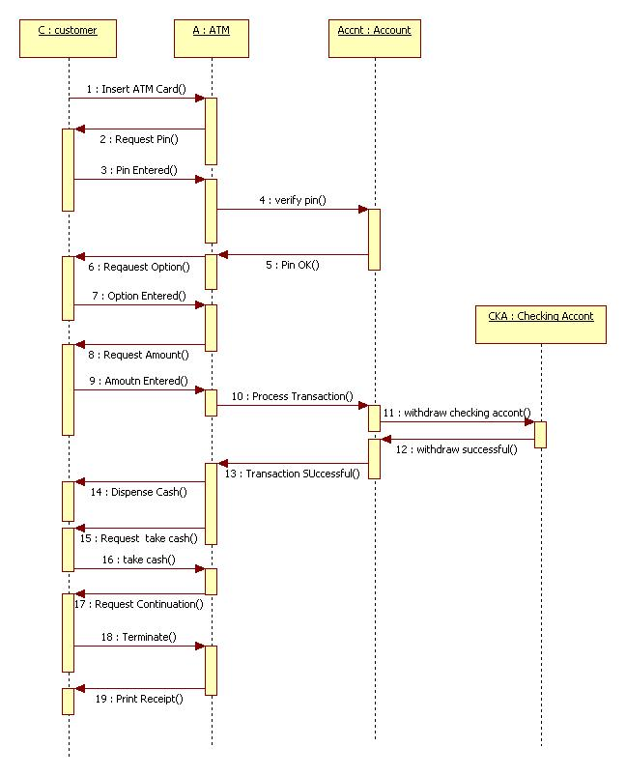
*ATM Example – Logical View (Sequence Diagram)
Sequence diagram: used to model interactions between design units
together with the messages exchanges and the time-order of the messages
* Example taken from: http://www.programsformca.com/2012/03/uml-diagrams-library-mgmt-system.html

Slide 9
The Process View
The process view focuses on the dynamic aspects of the system, i.e., its execution time behavior.
This view is an abstraction of processes or threads
Shows process synchronization and concurrency.
It presents how all execution units are organized at run-time
It contributes to non-functional requirements and quality attributes such as scalability and performance requirements.
The UML activity diagram and interaction overview diagram support this view.
The stakeholders of this view are usually the developers and integrators

Slide 10
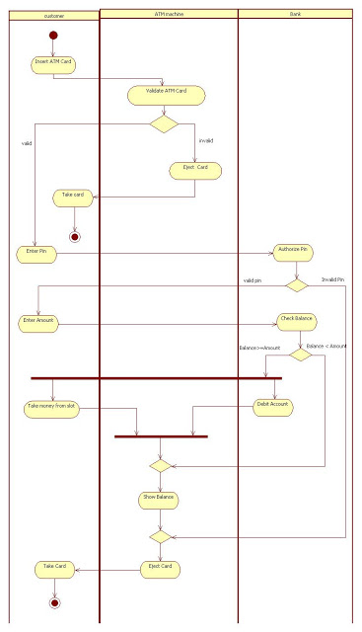
*ATM Example – Process View (Activity Diagram)
Activity diagram: helps to describe the flow the system, and explore operations and processes
Note: click on the diagram to view an online larger size diagram
* Example taken from: http://www.programsformca.com/2012/03/uml-diagrams-library-mgmt-system.html

Slide 11
The Development View
The development view describes the software static organization of the system modules. (from implementation point of view)
Modules such as class library, sub-system, or packages (building blocks that group classes)
UML diagrams such as package diagrams and component diagrams are often used to support this view.
This view can be used to analyze the system from the perspective of how logical components map to physical files and directories.
The stakeholders of this view can be programmers and software project manager

Slide 12
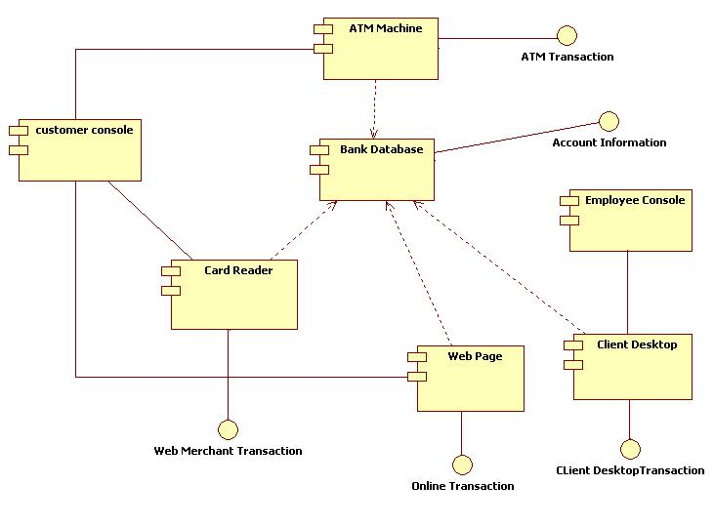
*ATM Example – Development View (Component Diagram)
Component diagram: shows components of a system and required interfaces, ports, and relationships between them
Full banking system
* Example taken from: http://www.programsformca.com/2012/03/uml-diagrams-library-mgmt-system.html

Slide 13
The Physical View
The physical view represents the deployment aspects of software systems
(from configuration and installation point of view)
The physical view can be modeled in UML using:
  Deployment diagrams
The physical view is appropriate to evaluate the system’s:
  Availability: for example, specifying the need for redundant nodes to increase the system’s availability
  Performance and scalability: for example, required processor speed, bandwidth, etc. to meet performance requirements.
  Security: for example, required firewalls
The stakeholders of this view are system installers, system administrators, and system engineers

Slide 14
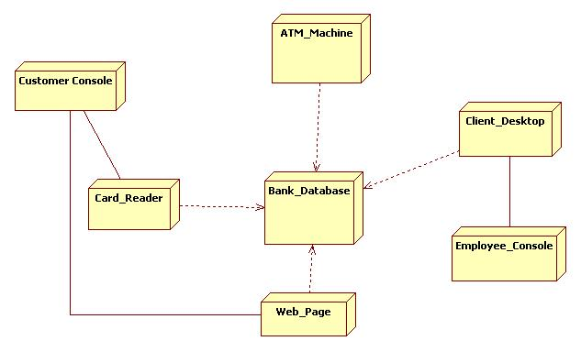
*ATM Example – Physical View (Deployment Diagram)
Deployment diagram:
A diagram used to model the physical structure of a software system
* Example taken from: http://www.programsformca.com/2012/03/uml-diagrams-library-mgmt-system.html

Slide 15
The User View (or Scenario view)
The scenario view describes the functionality of the system, i.e., how user will use the system and how the system provides services to the users.
This view provides a foundation for other 4 views and allow them to work together seamlessly and logically.
It helps designers discover architectural elements during design and helps to validate the architectural design afterward.
So, the scenario view helps to make the software architecture consistent and validated against functional and non-functional requirements.

Slide 16
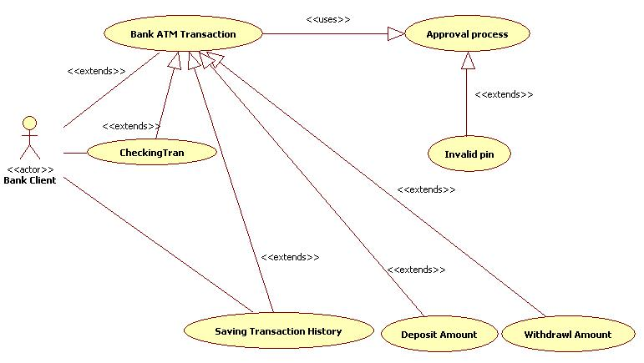
*ATM Example – User View (Use case diagram)
Use case diagram:
Behavioral diagram used to capture, specify, and visualize required system behavior
* Example taken from: http://www.programsformca.com/2012/03/uml-diagrams-library-mgmt-system.html

Slide 17
The 4+1 View Model (Summary)
* | Logical | Process | Development | Physical | Scenario
Description
Stake holder
UML – Diagram
* This table is taken from: https://www.tutorialspoint.com/software_architecture_design/architecture_models.htm

Slide 18
The 4+1 View Model (Summary)
* | Logical | Process | Development | Physical | Scenario
Description | Shows the components (Object) of system as well as their interaction | Shows the processes / Workflow rules of system and how those processes communicate, focuses on dynamic view of system | Gives building block views of system and describe static organization of the system modules | Shows the installation, configuration and deployment of software application | Shows the design is complete by performing validation and illustration
Stake holder | End-User, Analysts and Designer | Integrators & developers | Programmer and software project managers | System engineer, operators, system administrators and system installers | Stake holders of other views and their evaluators
Consider | Functional requirements | Non Functional Requirements | Software Module organization (Software management reuse, constraint of tools) | Nonfunctional requirement regarding to underlying hardware | System Consistency and validity
UML – Diagram | Class, State, Object, sequence, Communication Diagram | Activity Diagram | Component, Package diagram | Deployment diagram | Use case diagram
* This table is taken from: https://www.tutorialspoint.com/software_architecture_design/architecture_models.htm

Slide 19
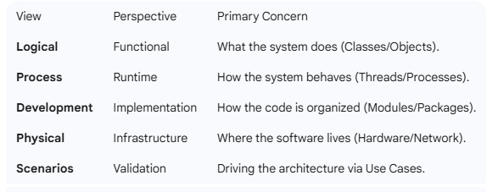
Summary Table

Slide 20
Summary
Designing the Architecture with the 4+1view model
  The Logical view
  The process view
  The development view
  The physical view
  Plus … The user view

